Slide 1
Indexing and Hashing
Cost estimation
Basic Concepts
Ordered Indices
B⁺ - Tree Index Files
B - Tree Index Files
Static Hashing
Dynamic Hashing
Comparison of Ordered Indexing and Hashing
Index Definition in SQL
Multiple-Key Access

Slide 2
Estimating Costs
For simplicity we estimate the cost of an operation by counting the number of blocks that are read or written to disk.
We ignore the possibility of blocked access which could significantly lower the cost of I/O.
We assume that each relation is stored in a separate file with B blocks and R records per block.

Slide 3
Basic Concepts
Indexing is used to speed up access to desired data.
  E.g. author catalog in library
A search key is an attribute or set of attributes used to look up records in a file. Unrelated to keys in the db schema.
An index file consists of records called index entries.
An index entry for key k may consist of
  An actual data record (with search key value k)
  A pair (k, rid) where rid is a pointer to the actual data record
  A pair (k, bid) where bid is a pointer to a bucket of record pointers
Index files are typically much smaller than the original file if the actual data records are in a separate file.
If the index contains the data records, there is a single file with a special organization.

Slide 4
Index Evaluation Metrics
Access time for:
  Equality searches – records with a specified value in an attribute
  Range searches – records with an attribute value falling within a specified range.
Insertion time
Deletion time
Space overhead

Slide 5
Types of Indices
The records in a file may be unordered or ordered sequentially by some search key.
A file whose records are unordered is called a heap file.
If an index contains the actual data records or the records are sorted by search key in a separate file, the index is called clustering (otherwise non-clustering).
In an ordered index, index entries are sorted on the search key value. Other index structures include trees and hash tables.
A primary index is an index on a set of fields that includes the primary key. Any other index is a secondary index.

Slide 6
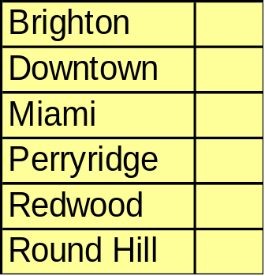
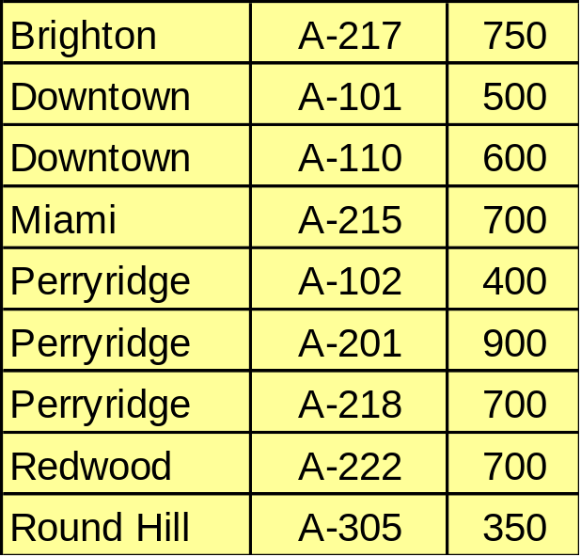
Dense Index Files
Dense index – index record appears for every search-key value in the file.

Slide 7
Sparse Index Files
A clustering index may be sparse.
Index records for only some search-key values.
To locate a record with search-key value k we:
  Find index record with largest search-key value < k
  Search file sequentially starting at the record to which the index record points
Less space and less maintenance overhead for insertions and deletions.
Generally slower than dense index for locating records.
Good tradeoff: sparse index with an index entry for every block in file, corresponding to least search-key value in the block.

Slide 8
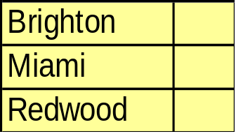
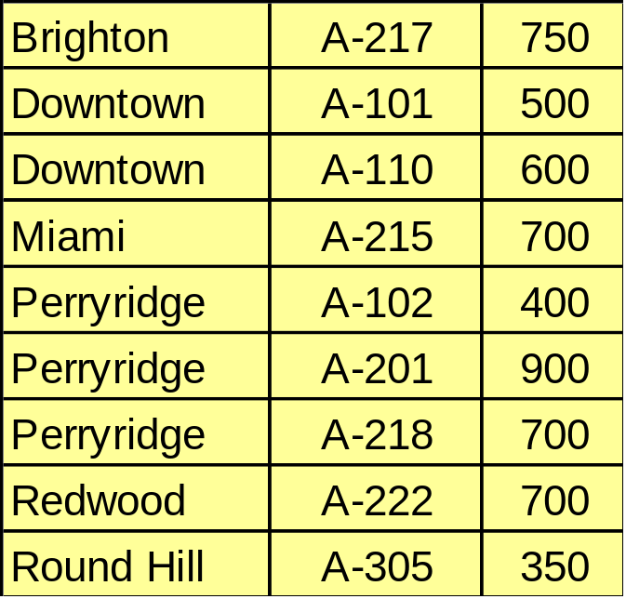
Example of Sparse Index Files

Slide 9
Multilevel Index
If an index does not fit in memory, access becomes expensive.
To reduce number of disk accesses to index records, treat the index kept on disk as a sequential file and construct a sparse index on it.
  outer index – a sparse index on main index
  inner index – the main index file
If even outer index is too large to fit in main memory, yet another level of index can be created, and so on.
Indices at all levels must be updated on insertion or deletion from the file.

Slide 10



Multilevel Index (Cont.)
outer index
inner index
Data
Block 0
Index
Block 0


Data
Block 1

Index
Block 1





Slide 11
Index Update: Deletion
If deleted record was the only record in the file with its particular search-key value, the search-key is deleted from the index also.
Single-level index deletion:
  Dense indices – deletion of search-key is similar to file record deletion.
  Sparse indices – if an entry for the search key exists in the index, it is deleted by replacing the entry in the index with the next search-key value in the file (in search-key order). If the next search-key value already has an index entry, the entry is deleted instead of being replaced.

Slide 12
Index Update: Insertion
Single-level index insertion:
  Perform a lookup using the search-key value appearing in the record to be inserted.
  Dense indices – if the search-key value does not appear in the index, insert it.
  Sparse indices – if index stores an entry for each block of the file, no change needs to be made to the index unless a new block is created. In this case, the first search-key value appearing in the new block is inserted into the index.
Multilevel insertion (as well as deletion) algorithms are simple extensions of the single-level algorithms

Slide 13
Non-clustering Indices
Frequently, one wants to find all the records whose values in a certain field satisfy some condition, and the file is not ordered on the field.
  Example 1: In the account database stored sequentially by account number, we may want to find all accounts in a particular branch.
  Example 2: As above, but where we want to find all accounts with a specified balance or range of balances.
We can have a non-clustering index with an index record for each search-key value. The index record points to a bucket that contains pointers to all the actual records with that particular search-key value.

Slide 14

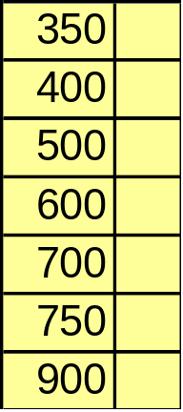
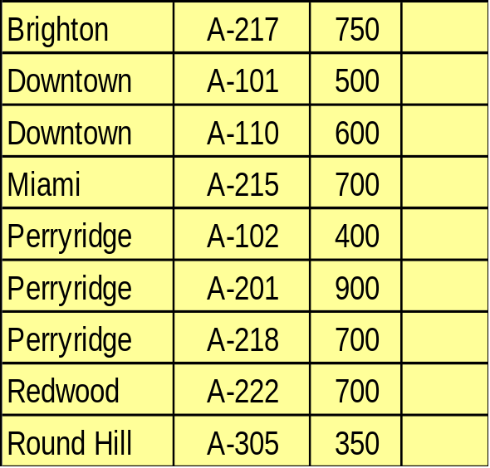

Secondary Index on balance field of account

Slide 15
Clustering and Non-clustering
Non-clustering indices have to be dense.
Indices offer substantial benefits when searching for records.
When a file is modified, every index on the file must be updated. Updating indices imposes overhead on database modification.
Sequential scan using clustering index is efficient, but a sequential scan using a non-clustering index is expensive – each record access may fetch a new block from disk.

Slide 16
B⁺ - Tree Index Files
B⁺- Tree indices are an alternative to indexed-sequential files.
Disadvantage of indexed-sequential files: performance degrades as file grows, since many overflow blocks get created. Periodic reorganization of entire file is required.
Advantage of B⁺ - tree index files: automatically reorganizes itself with small, local, change, in the face of insertions and deletions. Reorganization of entire file is not required to maintain performance.
Disadvantage of B⁺-tree: extra insertion and deletion overhead, space overhead.
Advantages of B+-trees outweigh disadvantages, and they are used extensively.

Slide 17
B⁺-Tree Index Files (Cont.)
A B⁺-tree is a rooted tree satisfying the following properties:
All paths from root to leaf are of the same length
Each node that is not a root or a leaf has between ⎡n/2⎤ and n children where n is the maximum number of pointers per node.
A leaf node has between ⎡(n – 1)/2⎤ and n – 1 values
Special cases: if the root is not a leaf, it has at least 2 children. If the root is a leaf (that is, there are no other nodes in the tree), it can have between 0 and n values.

Slide 18
B⁺-Tree Node Structure
Typical node
  K_{i} are the search-key values
  P_{i} are pointers to children (for non-leaf nodes) or pointers to records or buckets of records (for leaf nodes).
The search-keys in a node are ordered
K₁ < K₂ < K₃ < … < K_{n-1}
P₁
K₁
P₂
…
P_{n-1}
K_{n-1}
P_{n}

Slide 19
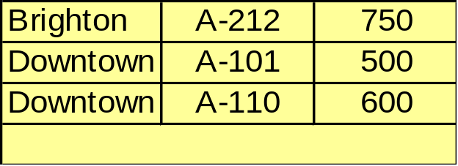
Leaf Nodes in B⁺-Trees
Properties of a leaf node:
For i = 1,2,…, n-1, pointer P_{i} either points to a file record with search-key value K_{i}, or to a bucket of pointers to file records, each record having search-key value K_{i}. Only need bucket structure if search-key does not form a superkey and the index is non-clustering.
If L_{i}, L_{j} are leaf nodes and i < j, L_{i}’s search-key values are less than L_{j}’s search-key values
P_{n} points to next leaf node in search-key order
leaf node

account file

Slide 20
Non-Leaf Nodes in B⁺-Trees
Non leaf nodes form a multi-level sparse index on the leaf nodes. For a non-leaf node with m pointers:
  All the search-keys in the subtree to which P_{i} points are less than K_{i}
  All the search-keys in the subtree to which P_{i} points are greater than or equal to K_{i−1}
P₁
K₁
P₂
…
P_{n-1}
K_{n-1}
P_{n}

Slide 21







Examples of a B⁺-tree
B⁺-tree for account file (n=3)

Slide 22
Example of a B⁺-tree
Leaf nodes must have between 2 and 4 values ( ⎡(n−1)/2⎤ and n − 1, with n=5).
Non-leaf nodes other than root must have between 3 and 5 children ( ⎡n/2⎤ and n with n = 5).
Root must have at least 2 children
B⁺-tree for account file (n=5)

Slide 23
Observations about B⁺ -trees
Since the inter-node connections are done by pointers, there is no assumption that in the B+-tree, the “logically” close blocks are “physically” close.
The non-leaf levels of the B+-tree form a hierarchy of sparse indices.
The B+-tree contains a relatively small number of levels (logarithmic in the size of the main file), thus searches can be conducted efficiently.
Insertions and deletions to the main file can be handled efficiently, as the index can be restructured in logarithmic time (as we shall see).

Slide 24
Queries on B⁺-Trees
Find all records with a search-key value of k.
  Start with the root node
  Examine the node for the smallest search-key value > k.
  If such a value exists, assume it is K_{i}. Then follow P_{i} to the child node
  Otherwise k ≥ K_{m-1}, where there are m pointers in the node, Then follow P_{m} to the child node.
  If the node reached by following the pointer above is not a leaf node, repeat the above procedure on the node, and follow the corresponding pointer.
  Eventually reach a leaf node. If key K_{i} = k, follow pointer P_{i} to the desired record or bucket. Else no record with search-key value k exists.

Slide 25
Queries on B⁺-Trees (Cont.)
In processing a query, a path is traversed in the tree from the root to some leaf node.
If there are K search-key values in the file, the path is no longer than ⎡log_{⎡n/2⎤}(K)⎤.
A node is generally the same size as a disk block, typically 4 kilobytes, and n is typically around 100 (40 bytes per index entry).
With 1 million search key values and n = 100, at most log₅₀(1,000,000) = 4 nodes are accessed in a lookup.
Contrast this with a balanced binary tree with 1 million search key values — around 20 nodes are accessed in a lookup
  above difference is significant since every node access may need a disk I/O, costing around 20 millisecond!

Slide 26
Updates on B+-Trees: Insertion
Find the leaf node in which the search-key value would appear
If the search-key value is already there in the leaf node, record is added to file and if necessary pointer is inserted into bucket.
If the search-key value is not there, then add the record to the main file and create bucket if necessary. Then:
  if there is room in the leaf node, insert (search-key value, record/bucket pointer) pair into leaf node at appropriate position.
  if there is no room in the leaf node, split it and insert (search-key value, record/bucket pointer) pair as discussed in the next slide.

Slide 27
Updates on B⁺-Trees: Insertion (Cont.)
Splitting a node:
  take the n(search-key value, pointer) pairs (including the one being inserted) in sorted order. Place the first ⎡n/2⎤ in the original node, and the rest in a new node.
  Let the new node be p, and let k be the least key value in p. Insert (k, p) in the parent of the node being split. If the parent is full, split it and propagate the split further up.
The splitting of nodes proceeds upwards till a node that is not full is found. In the worst case the root node may be split increasing the height of the tree by 1.

Slide 28








Updates on B+-Trees: Insertion(Cont.)

Slide 29
Updates on B+-Trees:Deletion
Find the record to be deleted, and remove it from the main file and from the bucket (if present)
Remove (search-key value, pointer) from the leaf node if there is no bucket or if the bucket has become empty
If the node has too few entries due to the removal, and the entries in the node and a sibling fit into a single node, then
  Insert all the search-key values in the two nodes into a single node (the one on the left), and delete the other node.
  Delete the pair (K_{i–1}, P_{i}), where P_{i} is the pointer to the deleted node, from its parent, recursively using the above procedure.

Slide 30
Updates on B+-Trees: Deletion
Otherwise, if the node has too few entries due to the removal, and the entries in the node and a sibling don’t fit into a single node, then
  Redistribute the pointers between the node and a sibling such that both have at least the minimum number of entries
  Update the corresponding search-key value in the parent of the node.
The node deletions may cascade upwards till a node which has ⎡n/2⎤ or more pointers is found. If the root node has only one pointer after deletion, it is deleted and the sole child becomes the root.

Slide 31

Examples of B⁺-Tree Deletion
The removal of the leaf node containing “Downtown” did not result in its parent having too little pointers. So the cascaded deletions stopped with the deleted leaf node’s parent.
Result after deleting “Downtown” from account

Slide 32

Examples of B+-Tree Deletion (Cont.)
The deleted “Perryridge” node’s parent became too small, but its sibling did not have space to accept one more pointer, so redistribution is performed. Observe that the root node’s search-key value changes as a result.
Deletion of “Perryridge” instead of “Downtown”

Slide 33
B⁺-Tree File Organization
Index file degradation problem is solved by using B⁺-Tree indices. Data file degradation problem is solved by using B⁺-Tree File Organization.
The leaf nodes in a B+-tree file organization store records, instead of pointers.
Since records are larger than pointers, the maximum number of records that can be stored in a leaf node is less than the number of pointers in a nonleaf node.
Leaf nodes are still required to be half full.
Insertion and deletion are handled in the same way as insertion and deletion of entries in a B⁺-tree index.
Good space utilization is important since records use more space than pointers. To improve space utilization, involve more sibling nodes in redistribution during splits and merges.

Slide 34
B-Tree Index Files
Similar to B+-tree, but B-tree allows search-key values to appear only once; eliminates redundant storage of search keys.
Search keys in nonleaf nodes appear nowhere else in the B-tree; an additional pointer field for each search key in a nonleaf node must be included.
Generalized B-tree leaf node
Nonleaf node — pointers B_{i} are the bucket or file record pointers.
P₁
K₁
P₂
…
P_{n-1}
K_{n-1}
P_{n}
P₁
B₁
K₁
P₂
B₂
K₂
…
P_{m-1}
B_{m-1}
K_{m-1}
P_{m}

Slide 35
B-Tree Index Files (Cont.)
Advantages of B-Tree indices:
  May use less tree nodes than a corresponding B⁺-Tree.
  Sometimes possible to find search-key value before reaching leaf node.
Disadvantages of B-Tree indices:
  Only small fraction of all search-key values are found early
  Non-leaf nodes are larger, so fan-out is reduced. Thus B-Trees typically have greater depth than corresponding B⁺-Tree.
  Insertion and deletion more complicated than in B⁺-Trees
  Implementation is harder than B⁺-Trees.
Typically, advantages of B-Trees do not outweigh disadvantages.

Slide 36
Static Hashing
A bucket is a unit of storage containing one or more records (a bucket is typically a disk block). In a hash file organization we obtain the bucket of a record directly from its search-key value using a hash function.
Hash function h is a function from the set of all search-key values K to the set of all bucket addresses B.
Hash function is used to locate records for access, insertion, and deletion.
Records with different search-key values may be mapped to the same bucket; thus entire bucket has to be searched sequentially to locate a record.

Slide 37
Hash Functions
Worst hash function maps all search-key values to the same bucket; this makes access time proportional to the number of search-key values in the file.
An ideal hash function is uniform, i.e. each bucket is assigned the same number of search-key values from the set of all possible values.
Ideal hash function is random, so each bucket will have the same number of records assigned to it irrespective of the actual distribution of search-key values in the file.
Typical hash functions perform computation on the internal binary representation of the search-key. For example, for a string search-key, the binary representations of all the characters in the string could be added and the sum modulo number of buckets could be returned.

Slide 38

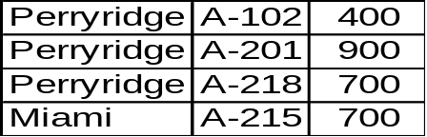



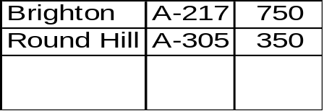

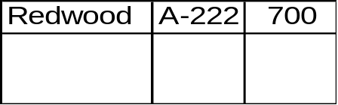
Example of Hash File Organization
bucket 0
bucket 5
bucket 1
bucket 6
bucket 2
bucket 7
bucket 3
bucket 8
bucket 4
bucket 9

Slide 39
Example of Hash File Organization (Cont.)
Hash file organization of account file, using branch-name as key.
(See figure in previous slide.)
There are 10 buckets.
The binary representation of the ith character is assumed to be the integer i.
The hash function returns the sum of the binary representations of the characters modulo 10.

Slide 40
Handling of Bucket Overflows
Bucket overflow can occur because of
  Insufficient buckets
  Skew in distribution of records. This can occur due to two reasons:
  multiple records have same search-key value
  chosen hash function produces non-uniform distribution of key values
Although the probability of bucket overflow can be reduced, it can not be eliminated; it is handled by using overflow buckets.
Overflow chaining — the overflow buckets of a given bucket are chained together in a linked list
Above scheme is called closed hashing. An alternative, called open hashing, is not suitable for database applications.

Slide 41
Hash Indices
Hashing can be used not only for file organization, but also for index-structure creation. A hash index organizes the search keys, with their associated record pointers, into a hash file structure.
Hash indices are always secondary indices — if the file itself is organized using hashing, a separate primary hash index on it using the same search-key is unnecessary. However, the term hash index is used to refer to both secondary index structures and hash organized files.

Slide 42

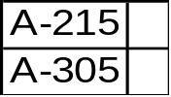
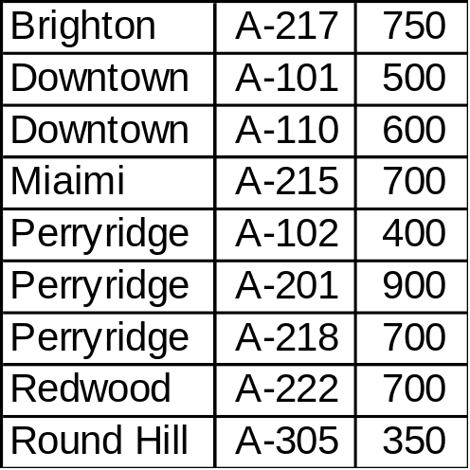
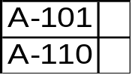
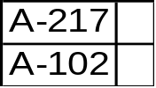


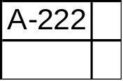
Example of Hash Index
bucket 0
bucket 1
bucket 2
bucket 3
bucket 4
bucket 5
bucket 6

Slide 43
Deficiencies of Static Hashing
In static hashing, function h maps search-key values to a fixed set B of bucket addresses.
  Databases grow with time. If initial number of buckets is too small, performance will degrade due to too much overflows.
  If file size at some point in the future is anticipated and number of buckets allocated accordingly, significant amount of space will be wasted initially.
  If database shrinks, again space will be wasted.
  One option is periodic, re-organization of the file with a new hash function, but it is very expensive.
These problems can be avoided by using techniques that allow the number of buckets to be modified dynamically.

Slide 44
Dynamic Hashing
Good for database that grows and shrinks in size
Allows the hash function to be modified dynamically
Extendable hashing – one form of dynamic hashing
  Hash function generates values over a large range — typically
  b-bit integers, with b = 32.
  At any time use only the last i bits of the hash function to index into a table of bucket addresses, where: 0 ≤ i ≤ 32
  Initially i = 0
  Value of i grows and shrinks as the size of the database grows and shrinks.
  Actual number of buckets is < 2^{i}, and this also changes dynamically due to merging and splitting of buckets.

Slide 45


General Extendable Hash Structure
i₁
bucket 1
i
hash suffix
..00
..01
i₂
..10
bucket 2
..11

i₃
bucket 3
bucket address table

In this structure, i₂ = i₃ = i, whereas i₁ = i – 1

Slide 46
Use of Extendable Hash Structure
Multiple entries in the bucket address table may point to a single bucket. Each bucket j stores a value i_{j}; all the entries that point to the same bucket have the same values on the last i_{j} bits of the hash suffix.
To locate the bucket containing search-key K_{j}:
1. Compute h(K_{j}) = X
2. Use the last i bits of X as a displacement into bucket
address table, and follow the pointer to appropriate bucket.
To insert a record with search-key value K_{i}, follow same procedure as look-up and locate the bucket, say j.
If there is room in the bucket j insert record in the bucket. Else the bucket must be split and insertion re-attempted. (See next slide.)

Slide 47
Updates in Extendable Hash Structure
To split a bucket j when inserting record with search-key value K_{i}:
  If i > i_{j} (more than one pointer to bucket j)
  allocate a new bucket z, and set i_{j} and j_{z} to the old i_{j}+1.
  Make the second half of the bucket address table entries pointing to j to point to z
  remove and reinsert each record in bucket j.
  recompute new bucket for K_{i} and insert record in the bucket (further splitting is required if the bucket is still full)
If i = i_{j} (only one pointer to bucket j)
  increment i and double the size of the bucket address table.
  replace each entry in the table by two entries that point to the same bucket.
  recompute new bucket address table entry for K_{i}. Now i > i_{j}, so use the first case above.

Slide 48
Update in Extendable Hash Structure (Cont.)
When inserting a value, if the bucket is full after several splits (that is, i reaches some limit b) create an overflow bucket instead of splitting bucket entry value further.
To delete a key value, locate it in its bucket and remove it. The bucket itself can be removed if it becomes empty (with appropriate updates to the bucket address table).
Merging of buckets and decreasing bucket address table size is also possible.

Slide 49

Use of Extendable Hash Structure: Example
branch-name
Brighton
Downtown
Miami
Perryridge
Redwood
Round Hill
h(branch-name)
0110 1101 1111 1011 0010 1100 0011 0000
0010 0011 1010 0000 1100 0110 1001 0001
1110 0111 1110 1101 1011 1111 0011 0011
1011 0001 0010 0100 1001 0011 0110 1111
0011 0101 1010 0110 1100 1001 1110 1110
1111 1000 0011 1111 1001 1100 0000 1101
0
0
bucket 1
bucket address table
Initial Hash Structure, Bucket size = 2

Slide 50
Example (2)
Insert account records from branches:
  1) Brighton
  2) Downtown
  3) Downtown
  4) Miami
  5) Perryridge
  6) Redwood
  7) Roundhill
  8) Redwood
  9) Downtown

Slide 51
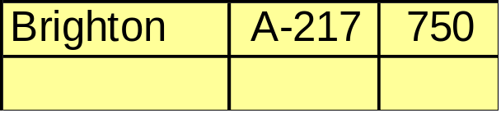

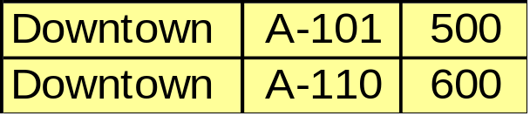
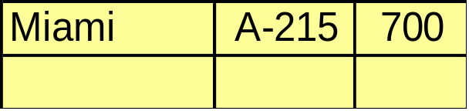
Example (3)
1
hash suffix
2
..00
..01
2
..10
..11
bucket address table
2
Hash Structure after four insertions

Slide 52
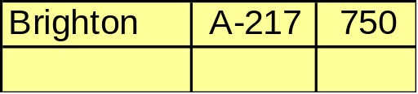
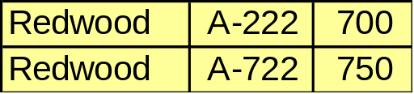


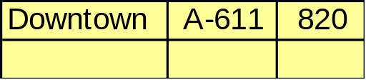
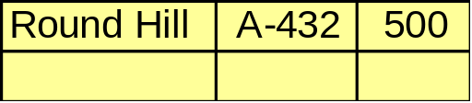
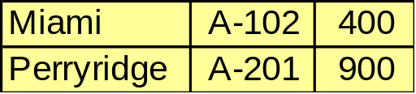
Example (4)
2
2
3
..000
..001
3
3
..010
..011
..100
..101
3
..110
..111
3
bucket address table
Hash Structure after all insertions

Slide 53
Comparison of Ordered Indexing and Hashing
Issues to consider:
Cost of periodic re-organization
Relative frequency of insertions and deletions
Is it desirable to optimize average access time at the expense of worst-case access time?
Expected type of queries:
  Hashing is generally better at retrieving records having a specified value of the key.
  If range queries are common, ordered indices are to be preferred

Slide 54
Index Definition in SQL
Create an index
create index <index-name> on <relation-name> (<attribute-list>)
E.g.: create index b-index on branch(branch-name)
Use create unique index to indirectly specify and enforce the condition that the search key is a candidate key.
To drop an index
drop index <index-name>

Slide 55
Multiple-Key Access
Use multiple indices for certain types of queries.
Example:
  select account-number
  from account
  where branch-name = “Perryridge” and Balance = 1000
Possible strategies for processing query using indices on single attributes:
  1. Use index on branch-name to find Perryridge records; test
  balance = 1000.
  2. Use index on balance to find accounts with balances of $1000; test branch-name = “Perryridge.”
  3. Use branch-name index to find pointers to all records pertaining to the Perryridge branch. Similarly use index on balance. Take intersection of both sets of pointers obtained.

Slide 56
Indices on Multiple Attributes
Suppose we have an ordered index on combined search-key
(branch-name, balance).
With the where clause
  where branch-name = “Perryridge” and balance = 1000
  the index on the combined search-key will fetch only records that
  satisfy both conditions.
Using separate indices is less efficient ⎯ we may fetch many records (or pointers) that satisfy only one of the conditions.
Can also efficiently handle
  where branch-name = “Perryridge” and balance < 1000
But cannot efficiently handle
  where branch-name < “Perryridge” and balance = 1000
  May fetch many records that satisfy the first but not the second
  condition.

